Slide 1
Designing Your Robot
Kevin Nufer
24 Apr 2017

Slide 2
What do you want to do?
Raise the voltage
Option 1: Boost Converter
Option 2: Get a battery with a higher voltage and use an H-bridge or a transistor
Lower the voltage
Option 1: Buck converter (UBEC)
Option 2: Use a linear regulator (there is a small one on your Arduino, but it can’t handle large amounts of current)

Slide 3
What do you want to do, cont.?
Use a servo
Requires an input of 5V
Use a buck converter on your 7.4V battery source
[what type of pin on Arduino?]
Electromagnet
Requires an input of 12V
Use a boost converter on your 7.4V battery source
H-Bridge (or a transistor/relay)
Stepper Motor
The H-bridge driving the 28BYJ-48 model purchased requires 5-12 V input
Voltage input needs to be directly from the battery (or at least not through the Arduino)

Slide 4
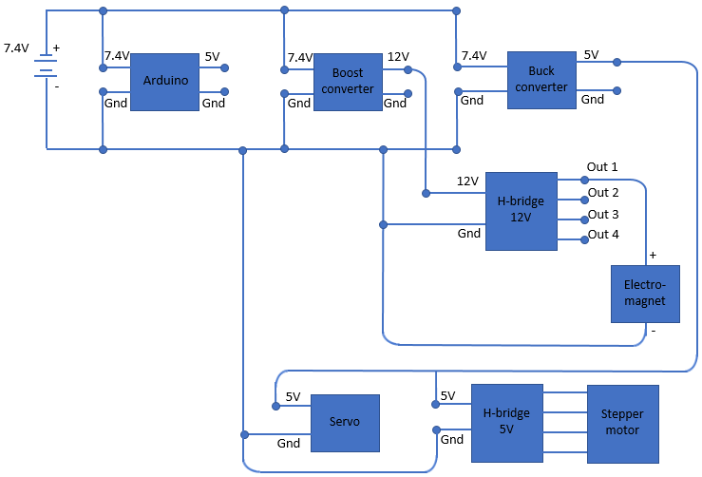
Subsystem example
To the right is an electrical diagram of a subsystem with an electromagnet, servo, and stepper motor
Not shown: the rest of the robot (the rest is tied in to the Arduino too)

Slide 5
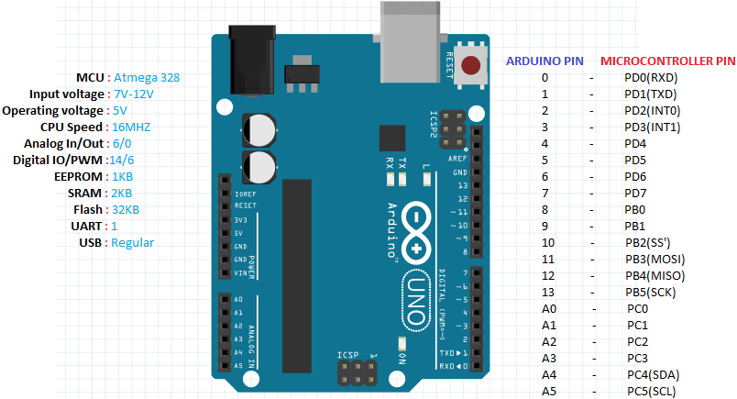
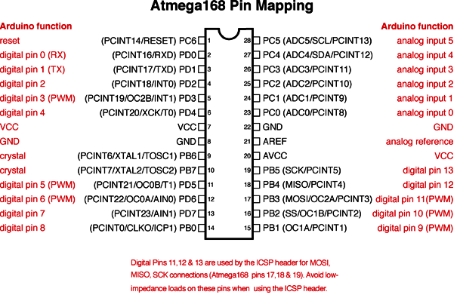

Slide 6
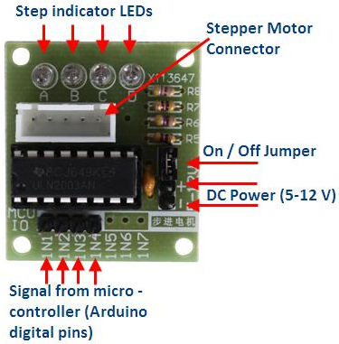
Connecting the Stepper Motor H-bridge to the Arduino
Connect the ULN2003 driver IN1, IN2, IN3 and IN4 to digital pins D3, D4, D5 and D6 respectively on the Arduino Uno.
These pins are necessary if you are using the “AccelStepper” library (which, if you use my code, you are)
Connect the positive lead from a decent 5-12V battery pack to the “+” pin of the ULN2003 driver and the ground to the “-” pin.
Make sure that the “on/off” jumper next to the “-” pin is on
If you power the Arduino from a different battery pack, connect the grounds together.

Slide 7
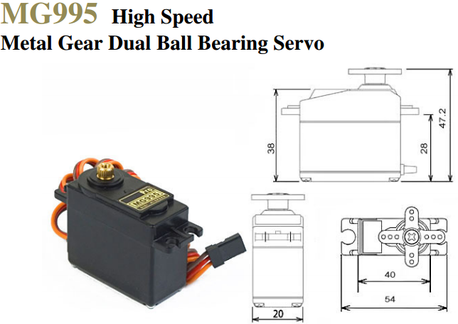
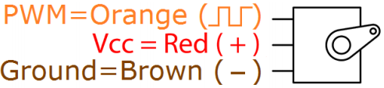
Servo
http://www.electronicoscaldas.com/datasheet/MG995_Tower-Pro.pdf
Specs
Weight: 55 g
Dimension: 40.7 x 19.7 x 42.9 mm approx.
Stall torque: 8.5 kgf·cm (4.8 V ), 10 kgf·cm (6 V)
Operating speed: 0.2 s/60º (4.8 V), 0.16 s/60º (6 V)
Operating voltage: 4.8 V a 7.2 V
Dead band width: 5 µs
Stable and shock proof double ball bearing design
Temperature range: 0 ºC – 55 ºC
How to hook up:

